Slide 1
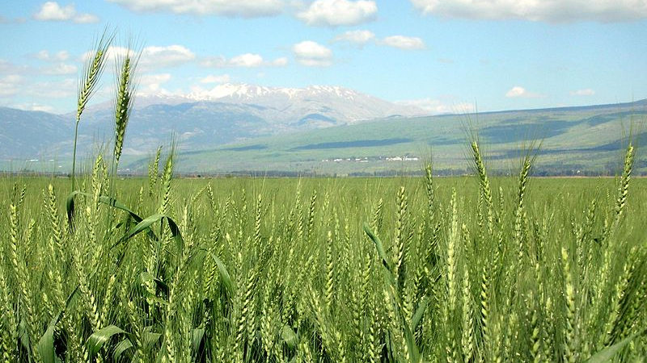
Fields of Joy

Slide 2
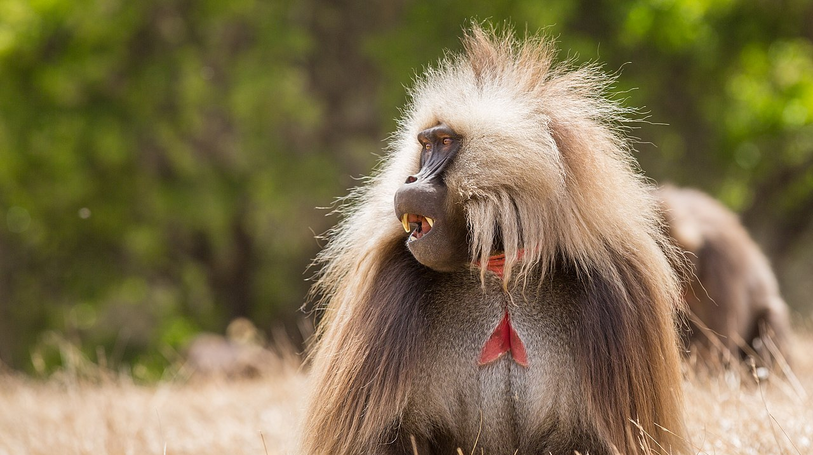
Theropithecus gelada
By Geertchaos - Own work, CC BY-SA 4.0, https://commons.wikimedia.org/w/index.php?curid=77060831

Slide 3
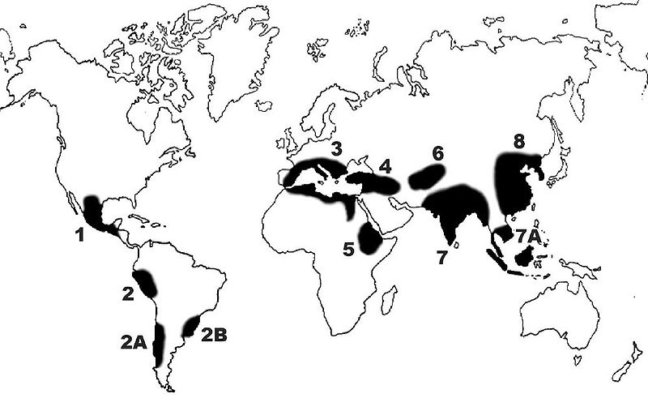
Origins of Agriculture
Occurred across the world ~12-10 KYa – Why?
Rice
Maize
Wheat
Barley

Slide 4
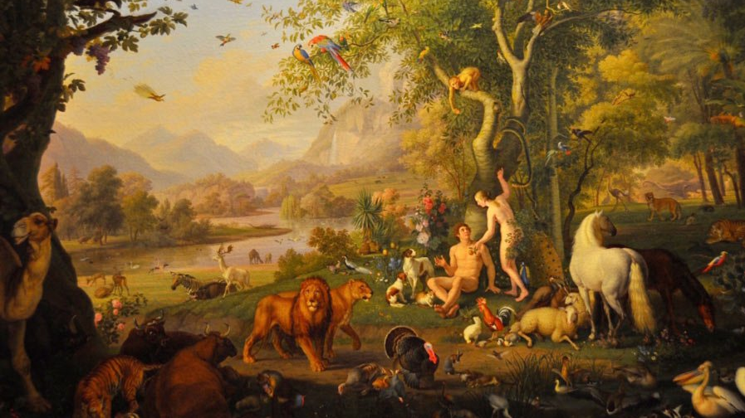


Slide 5
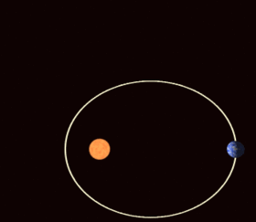
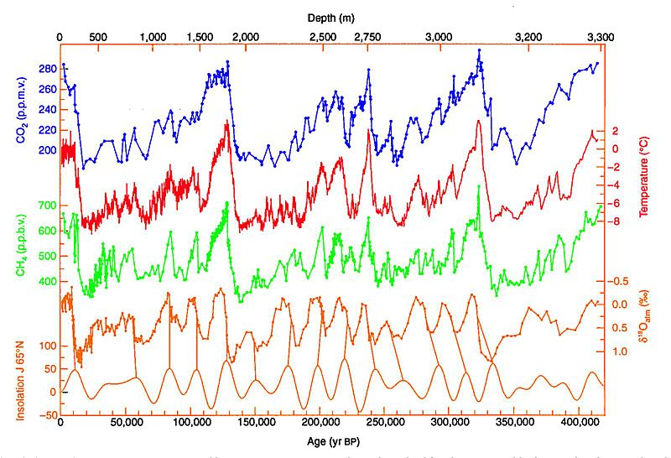
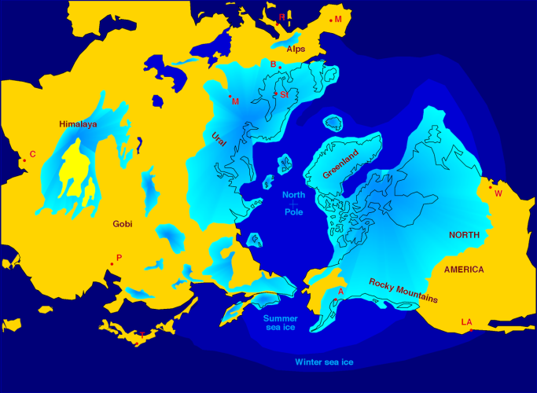
Milankovitch cycles
Irregularities in Earth’s orbit – solar radiation varies
~130 Ky cycle

Slide 6
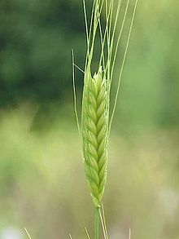
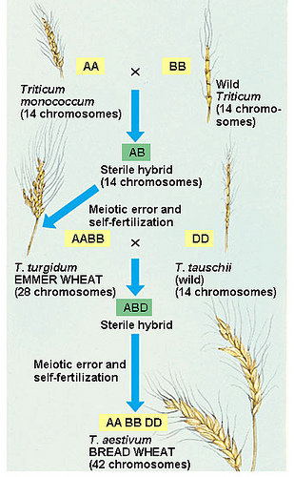
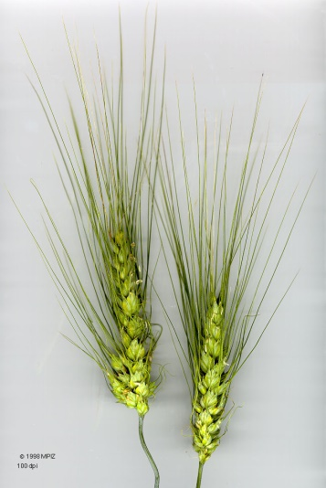
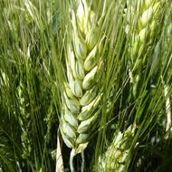
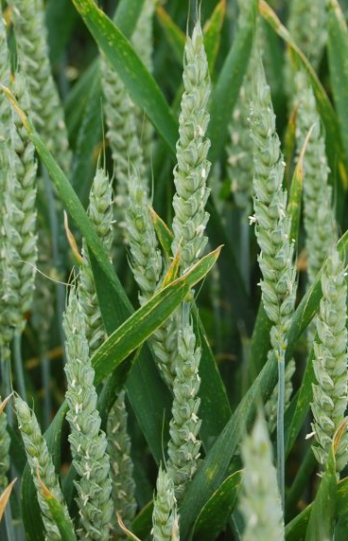
Evolution of Bread Wheat
Einkorn
Hybridisation
Emmer
Genome duplication – new species!
2nd Hybridisation - duplication
Durum – pasta
Bread wheat - hexaploid

Slide 8
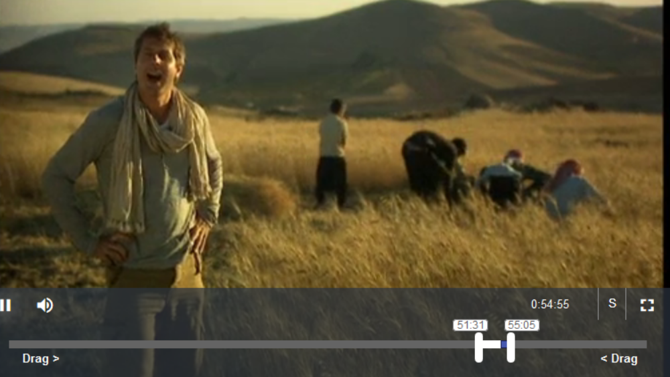
Graminivore Apes
https://learningonscreen.ac.uk/ondemand/index.php/clip/106770
3:30
Non-shattering phenotype
Also try reading this review - http://science.sciencemag.org/content/316/5833/1830.full

Slide 10
Green Revolution!

Slide 11
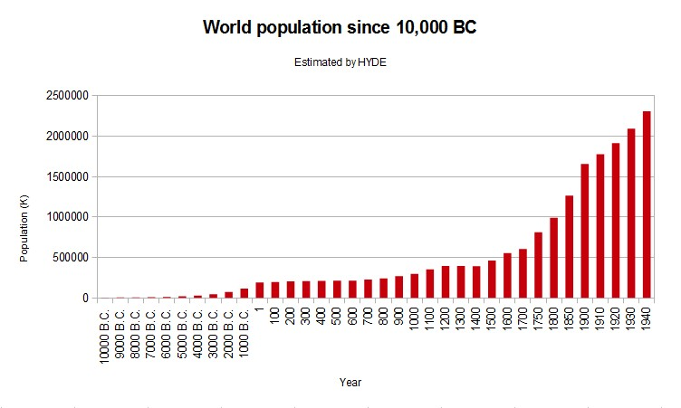
Current population 7.8 Billion

Slide 12
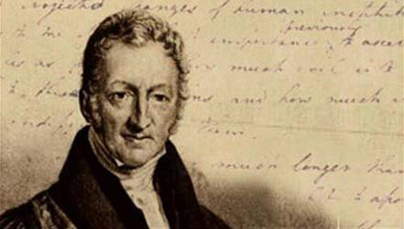
Thomas Malthus
An Essay on the Principle of Population
(1789)
That the increase of population is necessarily limited by the means of subsistence,
That population does invariably increase when the means of subsistence increase, and,
That the superior power of population is repressed by moral restraint, vice and misery

Slide 13
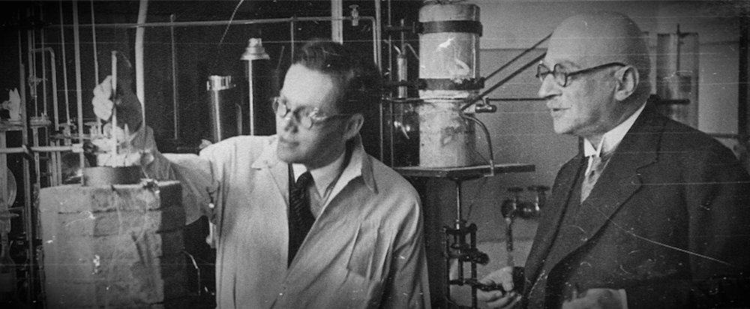
Haber Process
Fritz Haber and Carl Bosch
N₂ + 3H₂ → 2NH₃
∆H = -91.8 kJ .mol⁻¹
Very energy expensive

Slide 14
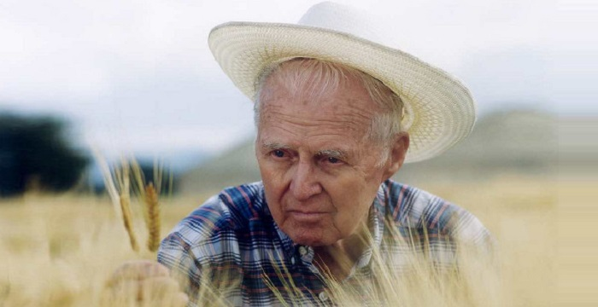
Norman Ernest Borlaug
1914-2009
Father of the ‘Green Revolution’
Nobel Peace Prize 1970

Slide 15
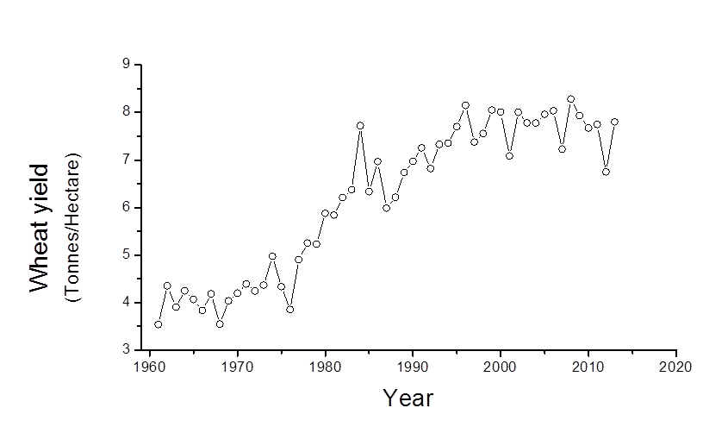
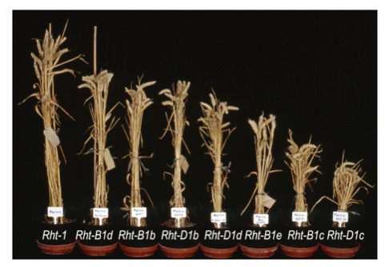
Dwarf Varieties
New Maximum
Requires chemicals
Shorter plants = higher harvest index
(harvest index = grain/total plant)
also - less lodging (falling over)
So higher yields

Slide 16
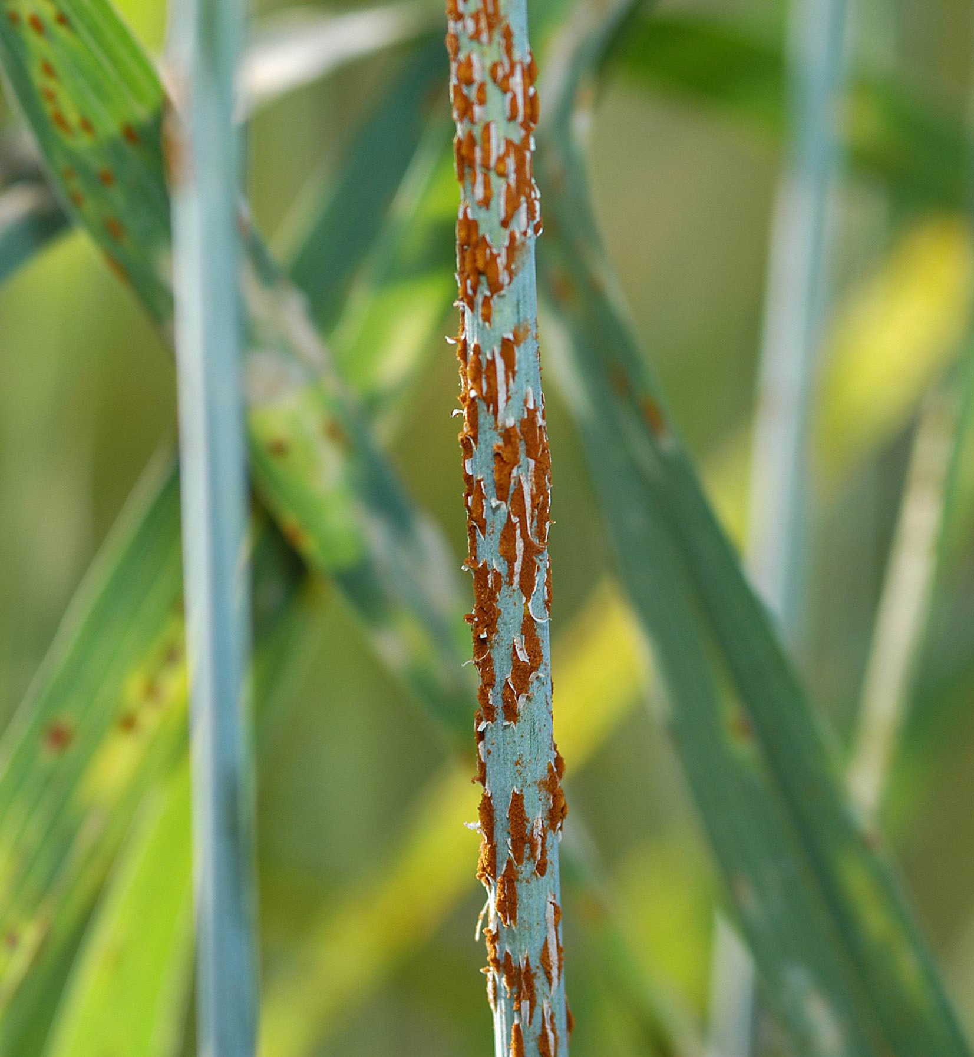
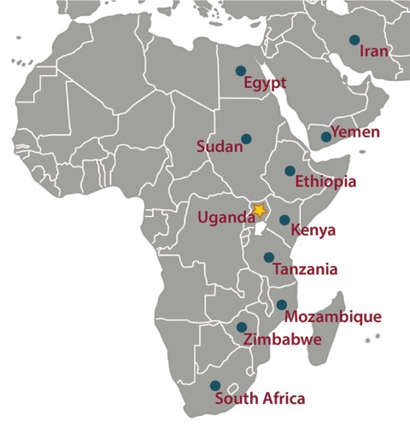
Wheat Stem Rust – Puccinia graminis
Rust reduces crop yields
Plant breeding produced resistance
New rust variety able to infect wheat crops in Africa
Thanks to Aleana Cairns

Slide 17
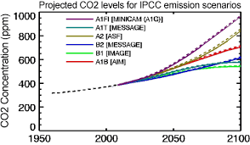
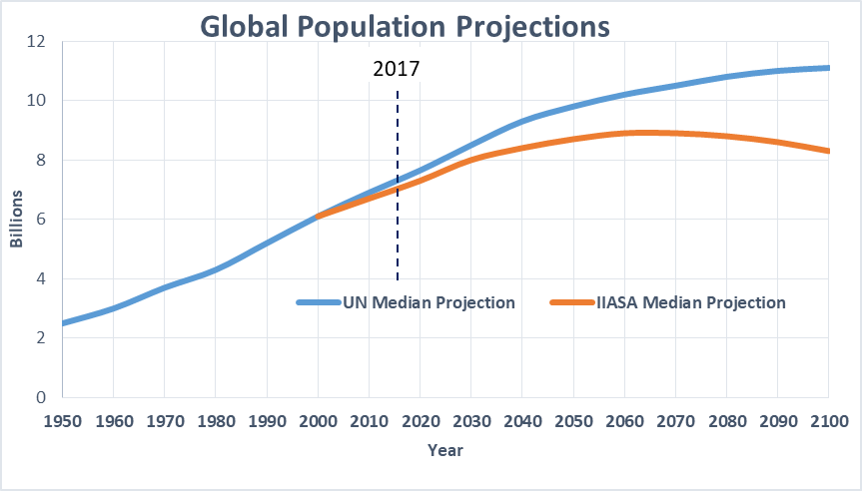
A changing world

Slide 18
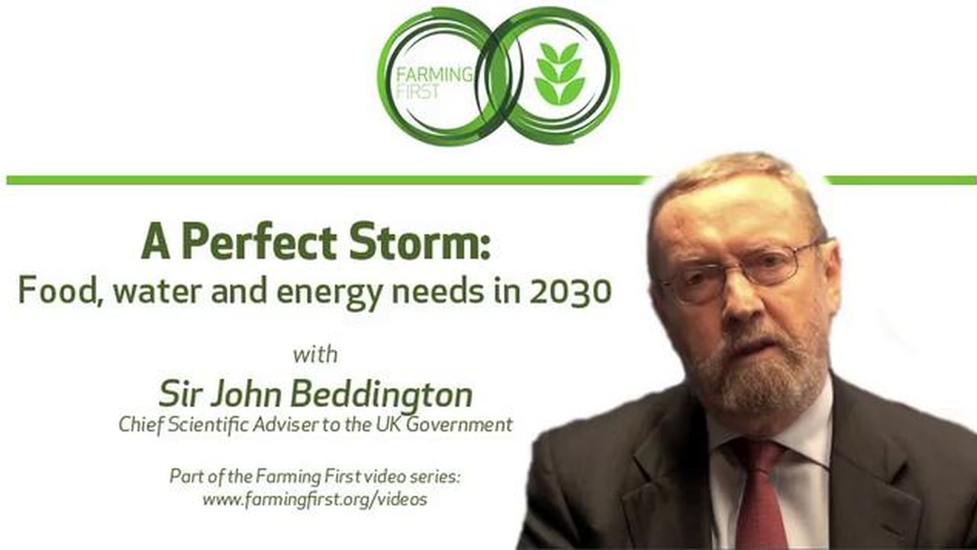
A Challenge for YOU…

Slide 19
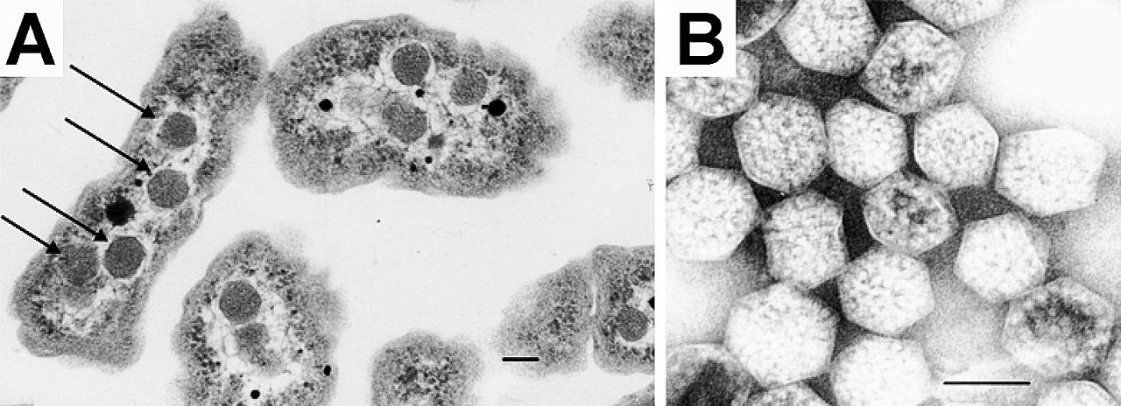

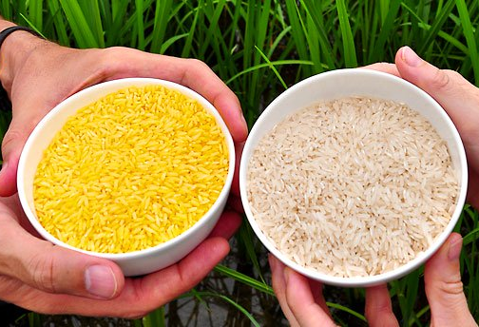
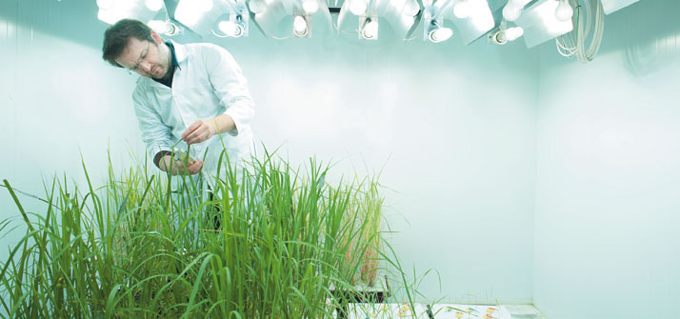
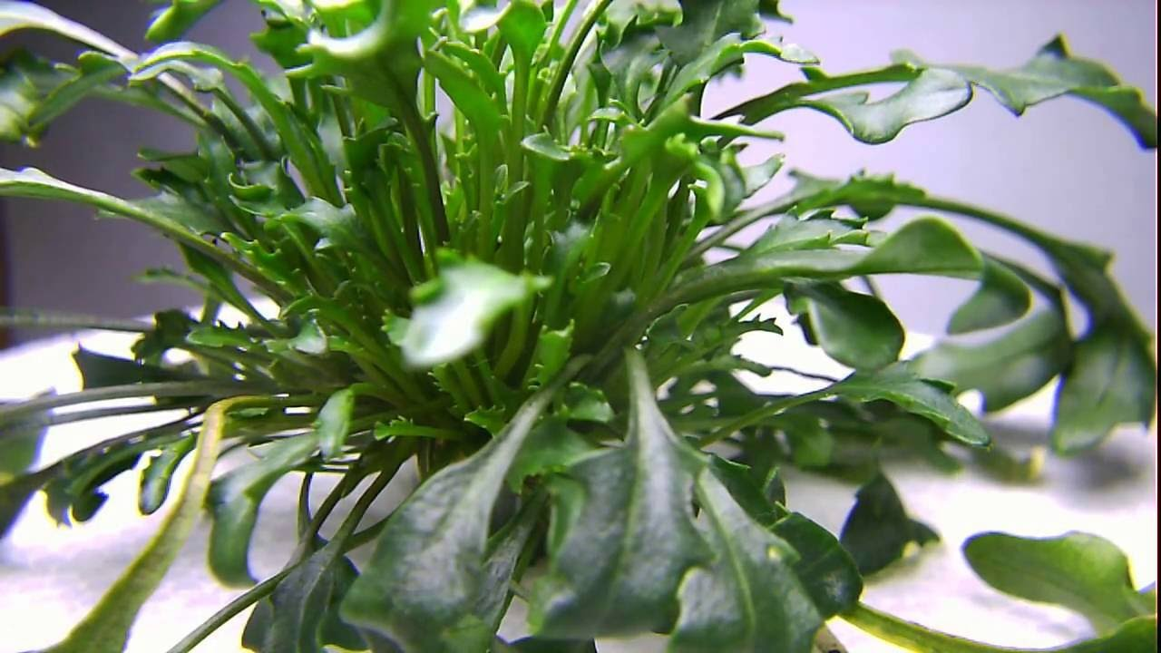

Food security - biotechnology
Learning lessons form cyanobacteria
Carboxysomes
Golden Rice
C4 Rice Project
Eutrema salsugineum – salt water cress

Slide 20
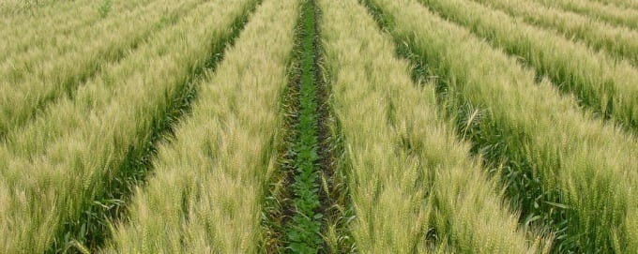
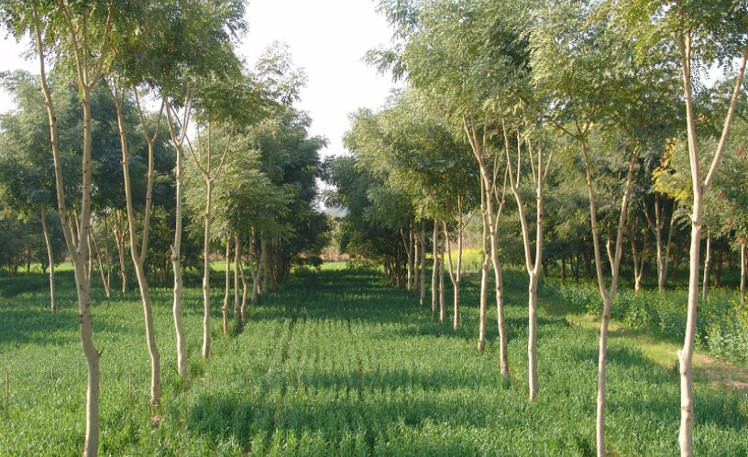
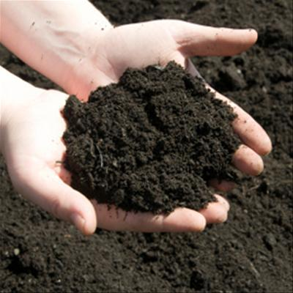
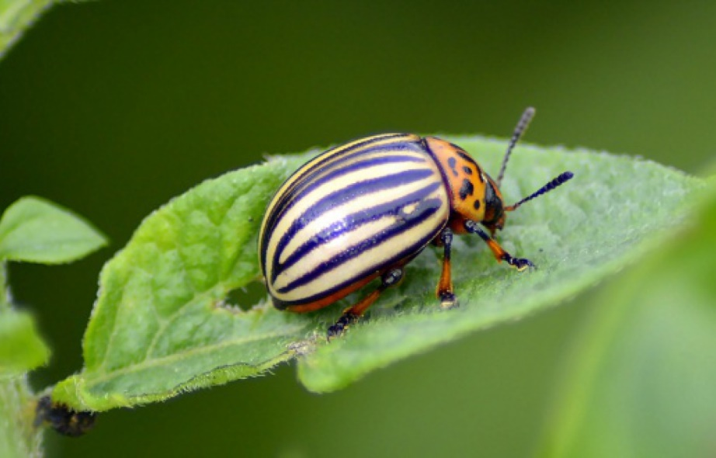
Food Security - agroecology
Agro-forestry
Intercropping
Soil management
Integrated pest management

